Slide 1



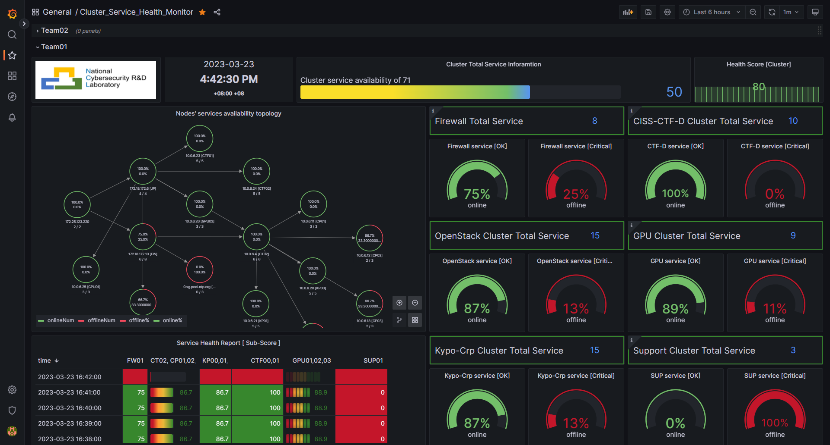




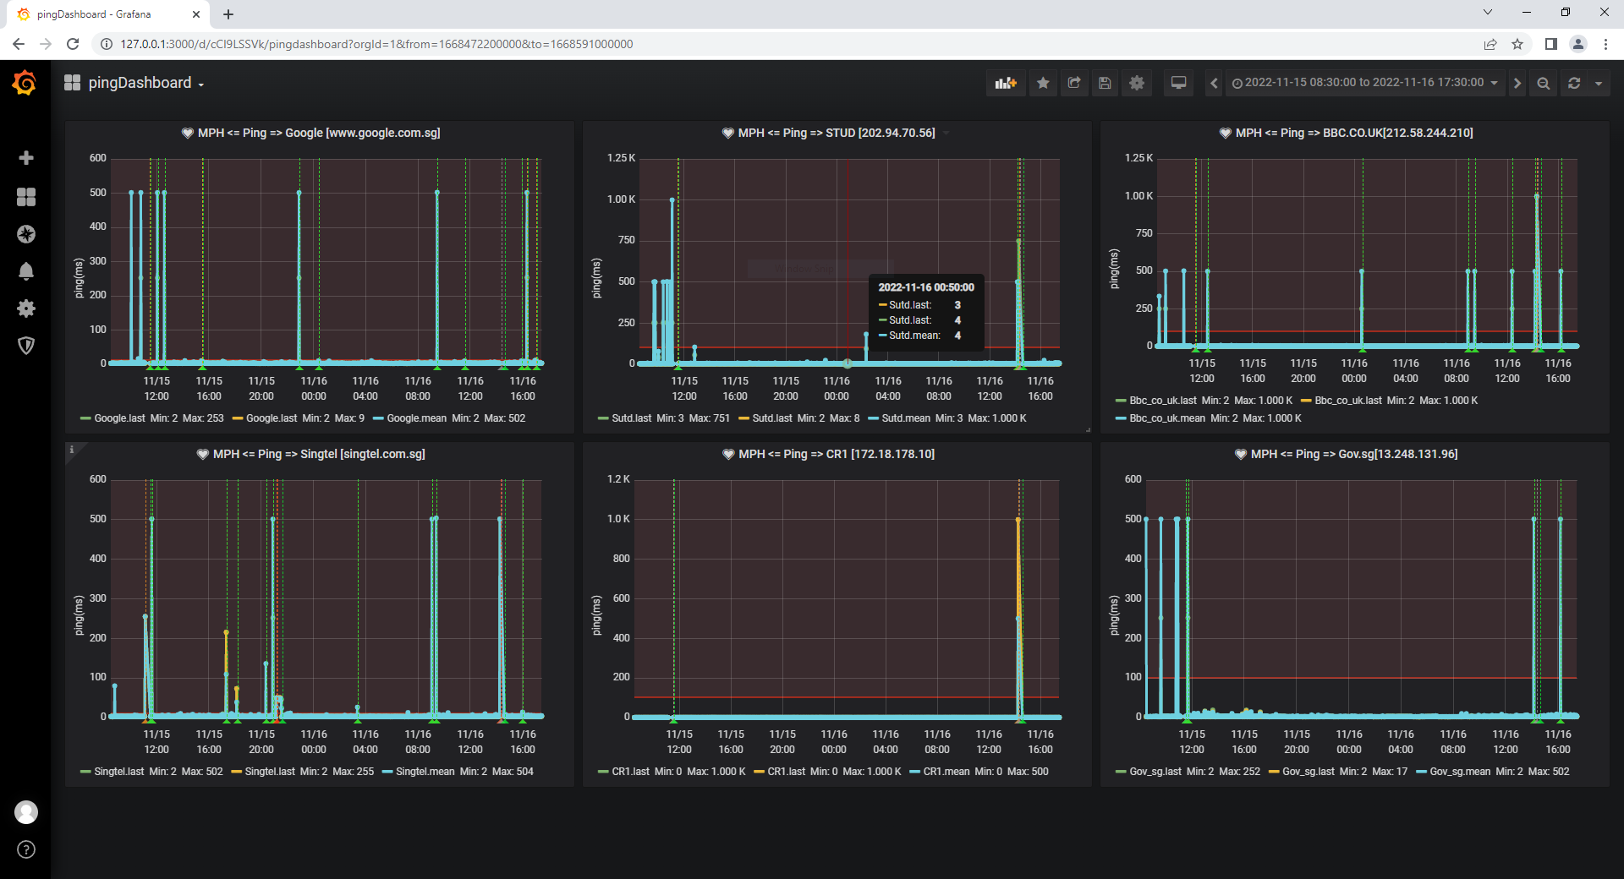



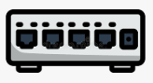
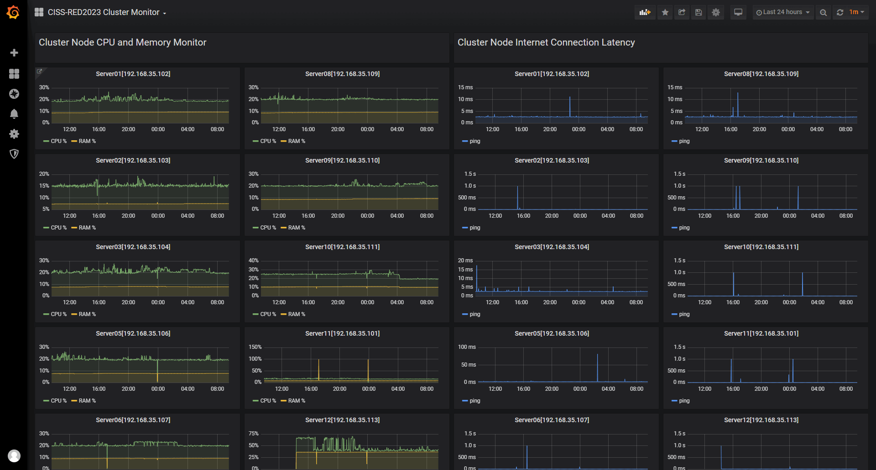

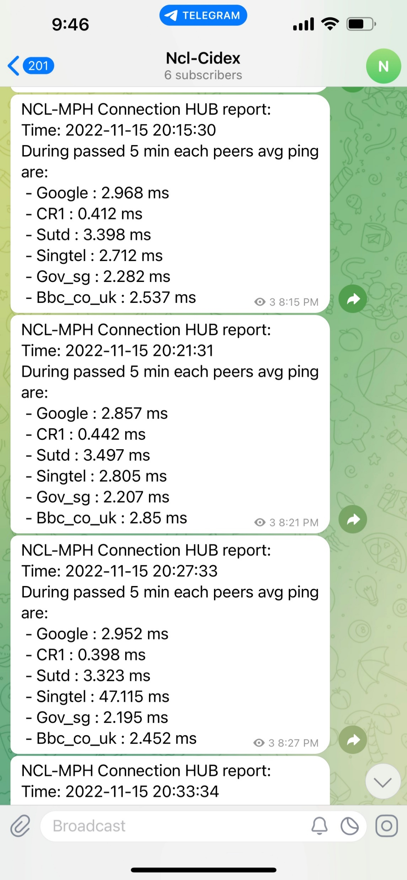

Building a Python Lightweight, Secure Cluster Monitor with InfluxDB and Grafana
CTF Participants
Physical server 1
Raw Database
Main Monitor Dashboards
CTF Challenge Host VMs
Communication Module
…
TX-VM1
TX-VM4
Monitor Hub
Internet
Cpu%,
Ram%, Ping
Data Manager
Network Node Dashboards
Monitor Agent
Firewall and Gateway
Physical server N
…
Monitor Agent
Physical server 14
Telegram Group
Challenge VM State Dashboards
CTF Challenge Host Dockers
Final Info Database
Forward Router
Telegram Alert Message Sender
Monitor Agent
Admin and Support Team
A Practical Guide Inspired by the CISSRed_Cluster_Monitor Project
Monitor Agent

Slide 2
CTF Participants
Physical server 1
CTF Challenge Host VMs
Raw Database
…
Communication Module
Monitor Hub
Internet
TX-VM1
TX-VM4
Cpu%,
Ram%, Ping
Monitor Agent
Data Manager
Firewall and Gateway
Physical server N
…
Monitor Agent
Message Sender
Physical server 14
Telegram Group
Info Database
CTF Challenge Host Dockers
Forward Router
Monitor Agent
Monitor Agent
Monitor Dashboards
Admin and Support Team

Slide 3
The cluster’s network topology and the service health of each monitored node/sub-cluster
The online and total service monitored count
Current service score and the score history diagram
Teams/Cluster selection drop down menu.
Service health percentage categorized by services type.
Score history
table of every sub-service cluster.

Slide 4

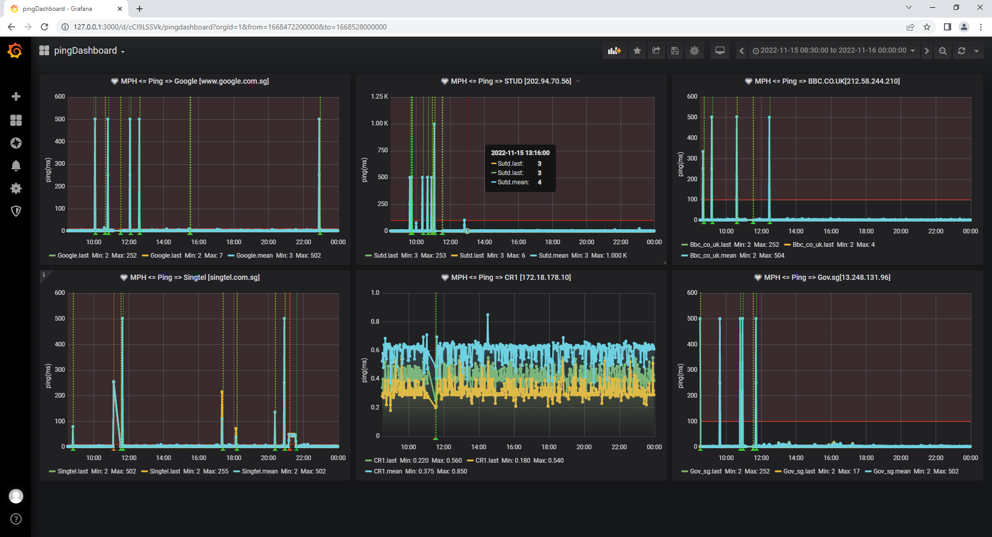
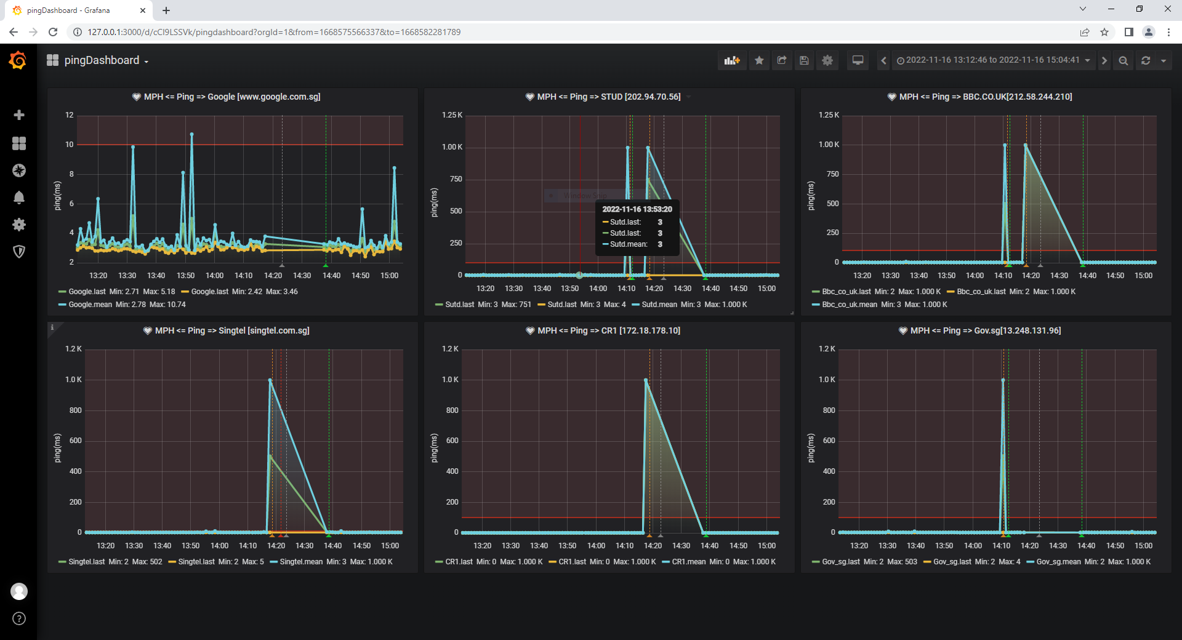
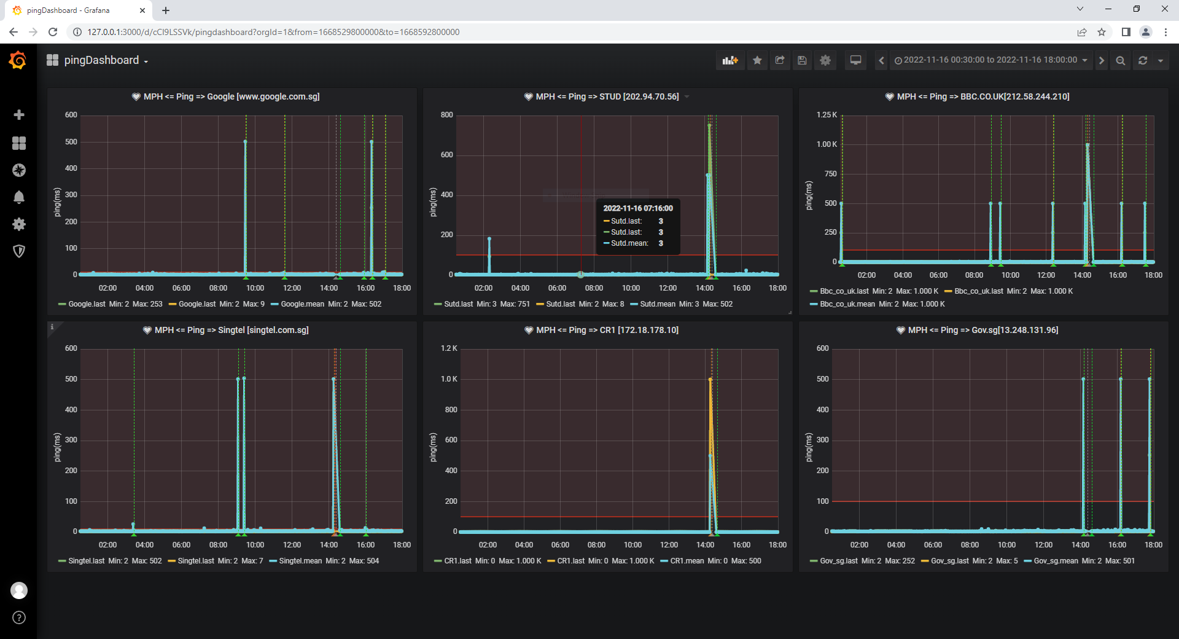
Use Case 1: CIDeX event main venue network monitor [result]
Event day-1 [15/11/2022] entire ping latency chart:
Event monitor result:
Ping client: 900KB raw ping record [text format].
Monitor hub: 600K DB raw + avg data, 1 network interrupt detect and reported.
Telegram-bot: 197 avg ping report in the channel.
Network interrupt [16/11/2022] detection result:
Event day-2 [16/11/2022] entire ping latency chart:

Slide 5
